Slide 1
Solving Geometry Problems
Pankaj Prateek, Jeetesh Mangwani

Slide 2
Overall Objectives
To develop a expert system that
Tutors the user on geometry construction problems
Also address the population speaking languages other than English

Slide 3
Objectives
To develop an expert system that
Draws simple geometric figures, given the construction steps
Supports multiple natural languages for expressing the input steps

Slide 4
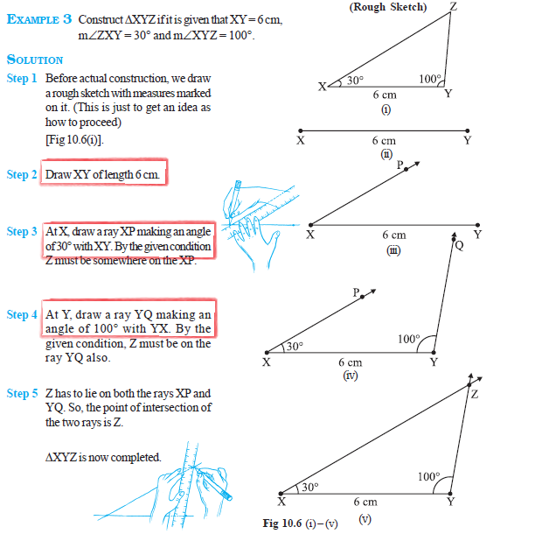
sample problems

Slide 5
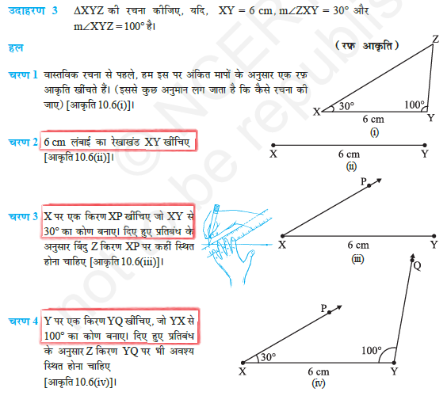
sample problems

Slide 6
RELATED works
Authors | Work
Gulwani et. al. [2] | Uses goal-based heuristic to simulate backward deduction; solves problem expressed in terms of predefined logical constructs
Schreck et. al.[5] | Uses CAD methods to deal with constrants
Itshaky et al.[3] | Uses number of nondeterministic choices as a measure of good solution
Ahmed, Umair et. Al.[1] | Uses domain specific measures to minimize parser errors and augment the geometry problem solver, GeoSynth

Slide 7
observations
Authors | Uses domain knowledge | Assumes linguistic clues already translated into logical constructs | Uses parse knowledge
Gulwani et. al. [2] | YES | YES | NA
Schreck et. al.[5] | YES | YES | NA
Itshaky et al.[3] | YES | YES | NA
Ahmed, Umair et. Al.[1] | YES | NO | YES

Slide 8
Characteristic features
No assumption language of the domain
No assumption about availability of parser
Scalable to any number of input languages
Cross-lingual Alignment

Slide 9
What is cross-lingual alignment?
Assigns probability to the event that a particular source language token corresponds to a particular target language token

Slide 10
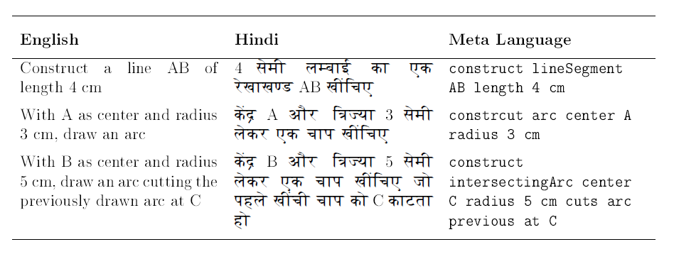
Sample corpus

Slide 11
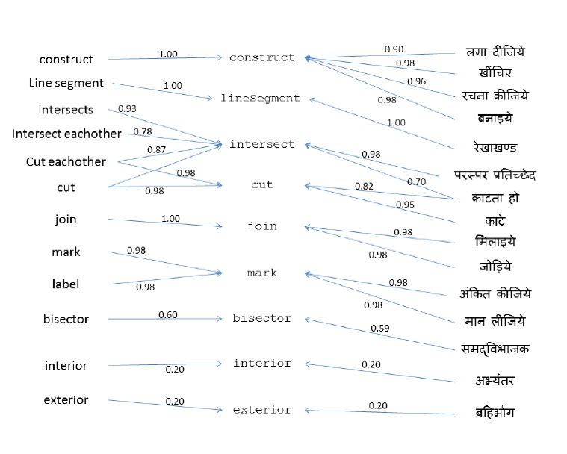
Sample alignment

Slide 12
alignments
Language A
Map
A to B
Language B
Map
B to A

Slide 13
Initial ideas
L0: Fixed predicate language (carefully designed)
NL[i]: ith natural language, 1<= i <= n
A[i]: word alignment between NL[i] and L0
Cross-lingual alignment
Alignment for
NL[i]
NL[i] sentences expressed in L0
(from corpus)
NL[i] sentences
(from corpus)

Slide 14
Initial ideas
L0: Fixed predicate language (carefully designed)
NL[i]: ith natural language, 1<= i <= n
A[i]: word alignment between NL[i] and L0
Any step expressed in NL[i]
Alignment for NL[i]
Possible L0 sentences
Interpreter
Graphic

Slide 15
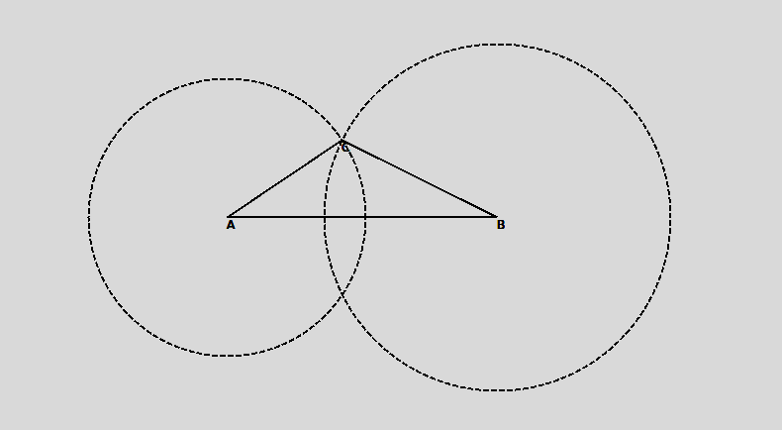
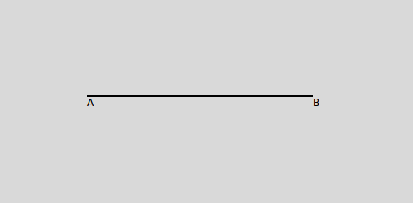
Sample run
Construct line segment AB of length 7.8 cm
With A and B as centers and radius 4 and 5 cm draw two arcs intersecting each other at C
Join AC
Join BC
7.8 सेमी लम्बाई का एक रेखाखण्ड AB खींचिए

Slide 16
difficulties
Anaphoras
“एक सुविधाजनक त्रिज्या लेकर पिछले चरण वाले चाप को बिंदु A पर काटें”
Underspecified Parameters
“With A and B as centers and a suitable radius, draw two arcs intersecting each other at point C”
Probabilistic Mapping
Mapped metalanguage sentence | Probability
Construct AB any length 7.8 cm | 0.71683
Construct AB lineSegment length 7.8 cm | 0.21081
Construct AB angle length 7.8 cm | 0.07232
Construct AB center length 7.8 cm | 1.90645e-06

Slide 17
Further work
Augment the corpus
Provide for bigger set of construction steps
Capture colloquial ways of expressions
Integrate into the bigger context of tutoring

Slide 18
references
[1] Umair Z Ahmed, Arpit Kumar, Monojit Choudhury, and Kalika Bali. Can modern statistical parsers lead to better natural language understanding for education? In Computational Linguistics and Intelligent Text Processing, pages 415427. Springer, 2012
[2] Sumit Gulwani, Vijay Anand Korthikanti, and Ashish Tiwari. Synthesizing geometry constructions. In ACM SIGPLAN Notices, volume 46, pages 5061. ACM, 2011.
[3] Shachar Itzhaky, Sumit Gulwani, Neil Immerman, and Mooly Sagiv. Solving geometry problems using a combination of symbolic and numerical reasoning. Technical report, Technical report, Tel Aviv University, 2012.
[4] Franz Josef Och and Hermann Ney. A systematic comparison of various statistical alignment models. Computational linguistics, 29(1):1951, 2003.
[5] Pascal Schreck, Pascal Mathis, and Julien Narboux. Geometric construction problem solving in computer-aided learning. In Tools with Articial Intelligence (ICTAI), 2012 IEEE 24th International Conference on, volume 1, pages 11391144. IEEE, 2012.
[6] Luke S Zettlemoyer and Michael Collins. Learning to map sentences to logical form: Structured classication with probabilistic categorial grammars. arXiv preprint arXiv:1207.1420, 2012.

Slide 19
Thank you!

Slide 20
GIZA++
GIZA++ is a statistical machine translation toolkit
Used to train IBM Models 1-5 and an HMM word alignment model.
http://code.google.com/p/giza-pp/
Franz Josef Och, Hermann Ney. "A Systematic Comparison of Various Statistical Alignment Models", Computational Linguistics, volume 29, number 1, pp. 19-51 March 2003.

